Slide 1

Department of FOT
01CE0101 - Computer Programming
Unit - 7
Pointers and
Dynamic Memory Allocation

Slide 2
Pointer
The pointer is a variable which stores the address of another variable.
This variable can be of type int, char, array, function, or any other pointer.
Example: to define a pointer which stores the address of an integer.
int n = 10;
Int*p = &n; // Variable p of type pointer is pointing to the address of the variable n of type integer.

Slide 3
Declaring a pointer
The pointer in c language can be declared using * (asterisk symbol).
It is also known as indirection pointer used to dereference a pointer.
int *a; //pointer to int
char *c; //pointer to char

Slide 4
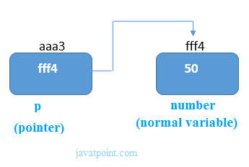
Pointer Example
Here pointer variable stores the address of number variable, i.e., fff4. The value of number variable is 50. But the address of pointer variable p is aaa3.
By the help of * (indirection operator), we can print the value of pointer variable p.

Slide 5
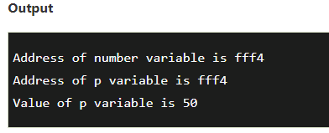
Example
#include<stdio.h>
int main()
{
int number=50;
int *p;
p=&number; //Assign Address
printf("Address of p variable is %x \n",p); // %x = Hexadecimal
printf("Value of p variable is %d \n",*p);
return 0;
}

Slide 6
Pointer to array
Pointer to an array is also known as array pointer. We are using the pointer to access the components of the array.
Example:
int arr[10];
int *p[10]=&arr; // Variable p of type pointer is pointing to the address of an integer array arr.

Slide 7
Pointer to a function
A pointer to a function points to the address of the executable code of the function.
You can use pointers to call functions and to pass functions as arguments to other functions.
You cannot perform pointer arithmetic on pointers to functions.
Example
void show (int);
void(*p)(int) = &show; // Pointer p is pointing to the address of a function

Slide 8
Pointer to a function
#include <stdio.h>
void show(int x) // Function Declaration
{
printf("Value is: %d\n", x);
}
int main() {
void (*p)(int) = show; // Now p points to the show function
p(10); // Calls show(10) through the function pointer p
return 0;
}
Output: Value is: 10

Slide 9
Pointer to a function
The type of a pointer to a function is based on both the return type and parameter types of the function.
A declaration of a pointer to a function must have the pointer name in parentheses. Function parameters have precedence over pointers in declarations, so parentheses are required to alter the precedence and declare a pointer to a function.
Without them, the compiler interprets the declaration as a function that returns a pointer to a specified return type.

Slide 10
Advantage of pointer
1) Pointer reduces the code and improves the performance, it is used to retrieving strings, trees, etc. and used with arrays, structures, and functions.
2) We can return multiple values from a function using the pointer.
3) It makes you able to access any memory location in the computer's memory.

Slide 11
Usage of pointer
There are many applications of pointers in c language.
1) Dynamic memory allocation
In c language, we can dynamically allocate memory using malloc() and calloc() functions where the pointer is used.
2) Arrays, Functions, and Structures
Pointers in c language are widely used in arrays, functions, and structures. It reduces the code and improves the performance.

Slide 12
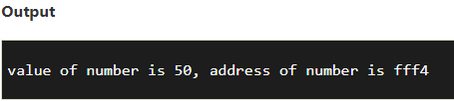
Address Of (&) Operator
The address of operator '&' returns the address of a variable. But, we need to use %u to display the address of a variable.
Example:
#include<stdio.h>
int main()
{
int number=50;
printf("value of number is %d, address of number is %u", number,&number);
return 0;
}

Slide 13
Pointer Arithmetic
We can perform arithmetic operations on the pointers like addition, subtraction, etc.
However, as we know that pointer contains the address, the result of an arithmetic operation performed on the pointer will also be a pointer if the other operand is of type integer.
In pointer-from-pointer subtraction, the result will be an integer value. Following arithmetic operations are possible on the pointer
Increment
Decrement
Addition
Subtraction
Comparison

Slide 14
Incrementing Pointer
If we increment a pointer by 1, the pointer will start pointing to the immediate next location.
It different from the general arithmetic since the value of the pointer will get increased by the size of the data type to which the pointer is pointing.
We can traverse an array by using the increment operation on a pointer which will keep pointing to every element of the array, perform some operation on that, and update itself in a loop.
Syntax:
new_address= current_address + i * size_of(data type)
Where (i) is the number by which the pointer get increased.

Slide 15
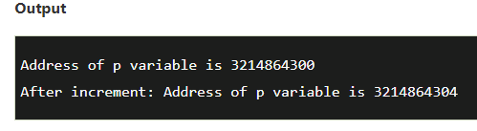
Example
#include<stdio.h>
int main()
{
int number=50;
int *p; //pointer to int
p=&number; //stores the address of number variable
printf("Address of p variable is %u \n",p);
p=p+1;
printf("After increment: Address of p variable is %u \n",p); // in our case, p will get incremented by 4 bytes.
return 0;
}

Slide 16
Decrementing Pointer
Like increment, we can decrement a pointer variable.
If we decrement a pointer, it will start pointing to the previous location.
Syntax:
new_address= current_address - i * size_of(data type)

Slide 17
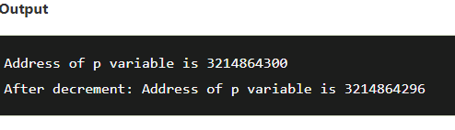
Example
#include <stdio.h>
void main()
{
int number=50;
int *p; //pointer to int
p=&number; //stores the address of number variable
printf("Address of p variable is %u \n",p);
p=p-1;
printf("After decrement: Address of p variable is %u \n",p); // P will now point to the immidiate previous location.
}

Slide 18
Pointer Addition
We can add a value to the pointer variable
Syntax:
new_address =
current_address + (number * size_of(data type))

Slide 19
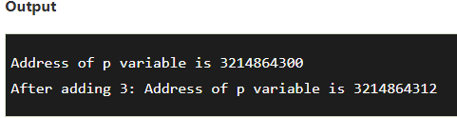
Pointer Addition
#include<stdio.h>
int main()
{
int number=50;
int *p; //pointer to int
p=&number; //stores the address of number variable
printf("Address of p variable is %u \n",p);
p=p+3; //adding 3 to pointer variable
printf("After adding 3: Address of p variable is %u \n",p);
return 0;
}

Slide 20
Pointer Subtraction
Like pointer addition, we can subtract a value from the pointer variable. Subtracting any number from a pointer will give an address. The formula of subtracting value from the pointer variable is given below:
Syntax:
new_address =
current_address - (number * size_of(data type))

Slide 21
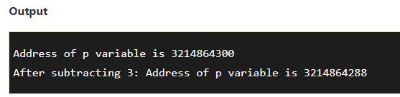
Pointer Subtraction
#include<stdio.h>
int main(){
int number=50;
int *p; //pointer to int
p=&number; //stores the address of number variable
printf("Address of p variable is %u \n",p);
p=p-3; //subtracting 3 from pointer variable
printf("After subtracting 3: Address of p variable is %u \n",p);
return 0;
}

Slide 22
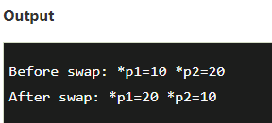
Swapping using pointer
Pointer Program to swap two numbers without using the 3rd variable.
#include<stdio.h>
int main()
{
int a=10, b=20,*p1=&a,*p2=&b;
printf("Before swap: *p1=%d *p2=%d",*p1,*p2);
*p1=*p1+*p2; // Step 1: a = a + b
*p2=*p1-*p2; // Step 2: b = a - b (original b)
*p1=*p1-*p2; // Step 3: a = a - b (original a)
printf("\nAfter swap: *p1=%d *p2=%d",*p1,*p2);
return 0;
}

Slide 23
Dynamic Memory Allocation

Slide 24
NULL Pointer
A pointer that is not assigned any value but NULL is known as the NULL pointer.
If you don't have any address to be specified in the pointer at the time of declaration, you can assign NULL value.
It will provide a better approach.
Example
int *p=NULL;
In the most libraries, the value of the pointer is 0 (zero).

Slide 25
NULL Pointer
#include <stdio.h>
int main()
{
int *ptr = NULL; // Null Pointer
printf("The value of ptr is %p", ptr);
return 0;
}

Slide 26
Void Pointer
Void pointer is a specific pointer type void * a pointer that points to some data location in storage, which doesn’t have any specific type.
Void pointers cannot be dereferenced. It can however be done using typecasting the void pointer
Pointer arithmetic is not possible on pointers of void due to lack of concrete value and thus size.

Slide 27
Void Pointer
#include <stdio.h>
int main()
{ Output:
int x = 4; Integer variable is = 4
float y = 5.5; Float variable is = 5.50000
void* ptr; // A void pointer
ptr = &x; // void pointer variable.
printf("Integer variable is = %d", *((int*)ptr));
ptr = &y; // void pointer is now float
printf("\nFloat variable is = %f", *((float*)ptr));
return 0;
}

Slide 28
Dynamic Memory Allocation
The Dynamic memory allocation enables the C programmers to allocate memory at runtime.
DMA can be defined as a procedure in which the size of a data structure is changed during the runtime.
There are 4 library functions provided by C defined under <stdlib.h> header file to facilitate dynamic memory allocation in C programming.
They are:
malloc() - memory allocation
calloc() - contiguous memory allocation
free() - free memory
realloc() - re allocation memory

Slide 29
malloc() method
“malloc” or “memory allocation” method in C is used to dynamically allocate a single large block of memory with the specified size.
It returns a pointer of type void which can be cast into a pointer of any form.
It initializes each block with default garbage value.
Syntax:
ptr = (cast-type*) malloc(byte-size)

Slide 30
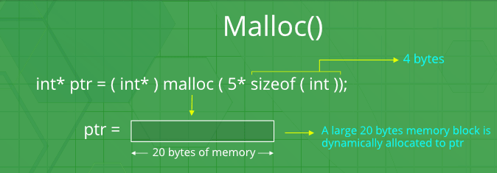
Example
For Example:
ptr = (int*) malloc(100 * sizeof(int));
Since the size of int is 4 bytes, this statement will allocate 400 bytes of memory. And, the pointer ptr holds the address of the first byte in the allocated memory.

Slide 31
calloc() method
“calloc” or “contiguous allocation” method in C is used to dynamically allocate the specified number of the specified type. of blocks of memory
It initializes each block with a default value ‘0’.
Syntax:
ptr = (cast-type*)calloc(n, element-size);
For Example:
ptr = (float*) calloc(25, sizeof(float));
This statement allocates contiguous space in memory for 25 elements each with the size of the float.

Slide 32
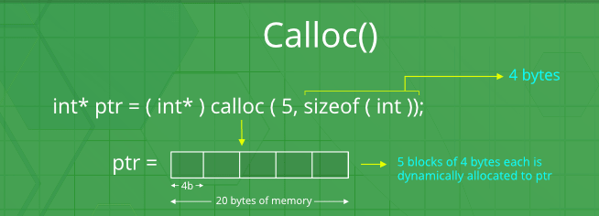
calloc() method

Slide 33
free() method
“free” method in C is used to dynamically
de-allocate the memory.
The memory allocated using functions malloc() and calloc() is not de-allocated on their own.
Hence the free() method is used, whenever the dynamic memory allocation takes place. It helps to reduce wastage of memory by freeing it.

Slide 34
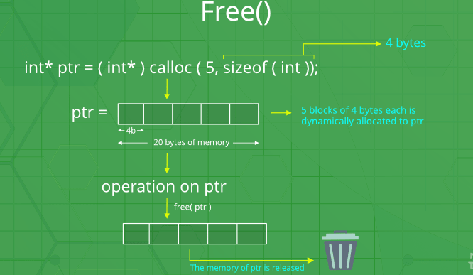
free() method
Syntax:
free(ptr);

Slide 35
realloc() method
“realloc” or “re-allocation” method in C is used to dynamically change the memory allocation of a previously allocated memory.
In other words, if the memory previously allocated with the help of malloc or calloc is insufficient, realloc can be used to dynamically re-allocate memory.
re-allocation of memory maintains the already present value and new blocks will be initialized with default garbage value.
Syntax:
ptr = realloc(ptr, newSize);
where ptr is reallocated with new size 'newSize'.

Slide 36
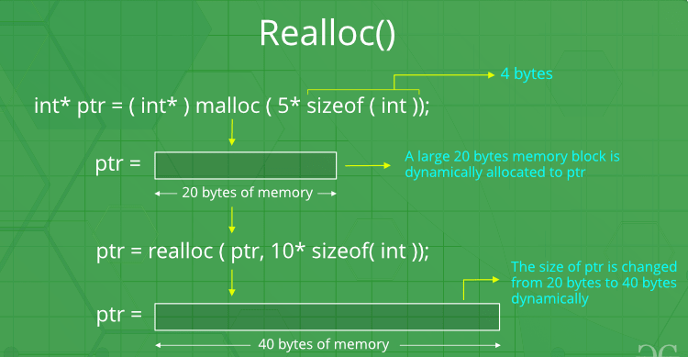
realloc() method

Slide 37
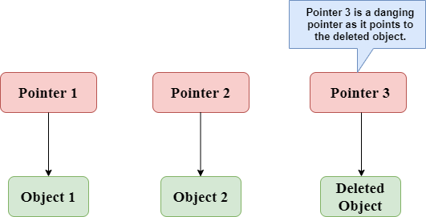
Dangling Pointer
A pointer pointing to a memory location that has been deleted (or freed) is called dangling pointer.
Example:
In the above figure, we can observe that the Pointer 3 is a dangling pointer. Pointer 1 and Pointer 2 are the pointers that point to the allocated objects, i.e., Object 1 and Object 2, respectively. Pointer 3 is a dangling pointer as it points to the de-allocated object.

Slide 38

THANK YOU

